Slide 1
Object Oriented Programming Concept

Slide 2
Java Method Overloading
With method overloading, multiple methods can have the same name with different parameters:
Example
int myMethod(int x)
float myMethod(float x)
double myMethod(double x, double y)
Consider the following example, which have two methods that add numbers of different type:

Slide 3
Block Scope
A block of code refers to all of the code between curly braces {}. Variables declared inside blocks of code are only accessible by the code between the curly braces, which follows the line in which the variable was declared:
Example
public class Main {
public static void main(String[] args) {
// Code here CANNOT use x
{ // This is a block
// Code here CANNOT use x
int x = 100;
// Code here CAN use x
System.out.println(x);
} // The block ends here
// Code here CANNOT use x
}
}
A block of code may exist on its own or it can belong to an if, while or for statement. In the case of for statements, variables declared in the statement itself are also available inside the block's scope.

Slide 4
Java Recursion
Recursion is the technique of making a function call itself. This technique provides a way to break complicated problems down into simple problems which are easier to solve.
Recursion may be a bit difficult to understand. The best way to figure out how it works is to experiment with it.

Slide 5
Example
Use recursion to add all of the numbers between 5 to 10.
public class Main {
public static void main(String[] args) {
int result = sum(5, 10);
System.out.println(result);
}
public static int sum(int start, int end) {
if (end > start) {
return end + sum(start, end - 1);
} else {
return end;
}
}
}

Slide 6
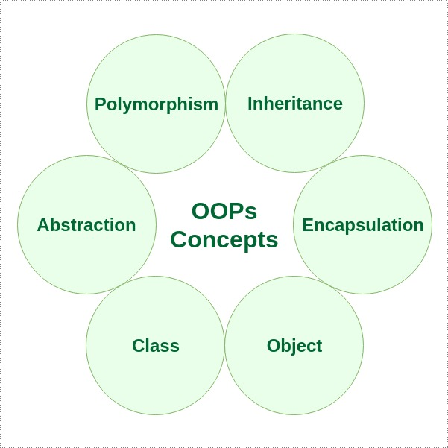

Slide 7
Java - What is OOP?
OOP stands for Object-Oriented Programming.
Procedural programming is about writing procedures or methods that perform operations on the data, while object-oriented programming is about creating objects that contain both data and methods.
Object-oriented programming has several advantages over procedural programming:
OOP is faster and easier to execute
OOP provides a clear structure for the programs
OOP helps to keep the Java code DRY "Don't Repeat Yourself", and makes the code easier to maintain, modify and debug
OOP makes it possible to create full reusable applications with less code and shorter development time
Tip: The "Don't Repeat Yourself" (DRY) principle is about reducing the repetition of code. You should extract out the codes that are common for the application, and place them at a single place and reuse them instead of repeating it.

Slide 8
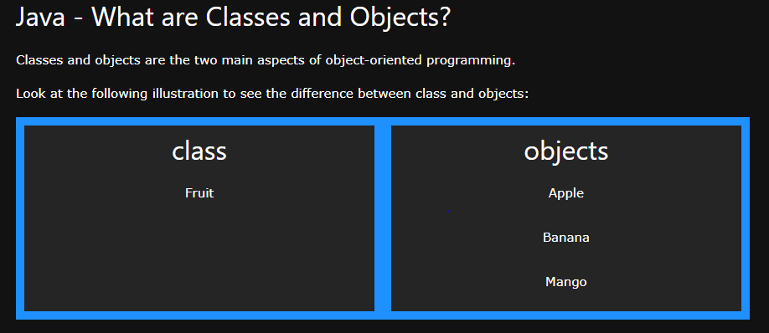

Slide 9
Java Classes/Objects
Java is an object-oriented programming language.
Everything in Java is associated with classes and objects, along with its attributes and methods. For example: in real life, a car is an object. The car has attributes, such as weight and color, and methods, such as drive and brake.
A Class is like an object constructor, or a "blueprint" for creating objects.

Slide 10
Create a Class
To create a class, use the keyword class:
Main.java
Create a class named "Main" with a variable x:
public class Main {
int x = 5;
}

Slide 11
Create an Object
In Java, an object is created from a class. We have already created the class named MyClass, so now we can use this to create objects.
To create an object of MyClass, specify the class name, followed by the object name, and use the keyword new:
Example
Create an object called "myObj" and print the value of x:
public class Main {
int x = 5;
public static void main(String[] args) {
Main myObj = new Main();
System.out.println(myObj.x);
}
}

Slide 12
Java Class Attributes
In the previous chapter, we used the term "variable" for x in the example (as shown below). It is actually an attribute of the class. Or you could say that class attributes are variables within a class:
Example
Create a class called "Main" with two attributes: x and y:
public class Main {
int x = 5;
int y = 3;
}

Slide 13
Static vs. Non-Static
You will often see Java programs that have either static or public attributes and methods.
In the example above, we created a static method, which means that it can be accessed without creating an object of the class, unlike public, which can only be accessed by objects:

Slide 14
Example
An example to demonstrate the differences between static and public methods:
public class Main {
// Static method
static void myStaticMethod() {
System.out.println("Static methods can be called without creating objects");
}
// Public method
public void myPublicMethod() {
System.out.println("Public methods must be called by creating objects");
}
// Main method
public static void main(String[] args) {
myStaticMethod(); // Call the static method
// myPublicMethod(); This would compile an error
Main myObj = new Main(); // Create an object of Main
myObj.myPublicMethod(); // Call the public method on the object
}
}

Slide 15
Access Methods With an Object

